Slide 1
Data Mining Group Project
G2103100K Qin Molei
G2103099G Tao Ran
G2103106C Wang Qingguo
G2103131A Wu Mingjing
G2103160J Zhou Duo

Slide 2
Data Set Description
The data is related with direct marketing campaigns (phone calls) of a Portuguese banking institution. Features information is stated as follow:
Age
Job
Education
Marital (marital status)
Default (has credit in default? )
Housing (has housing loan?)
Loan (has personal loan?)
Contact (contact communication type)
Month (last contact month of year)
Day (last contact day of the week)
Duration (last contact duration, in seconds)
Campaign (number of contacts performed during this campaign and for this client)
Pdays (number of days that passed by after the client was last contacted from a previous campaign)
Previous (number of contacts performed before this campaign and for this client)
Poutcome (outcome of the previous marketing)
Y (has the client subscribed a term deposit?)
Notes:
We have 15 features and one label

Slide 3
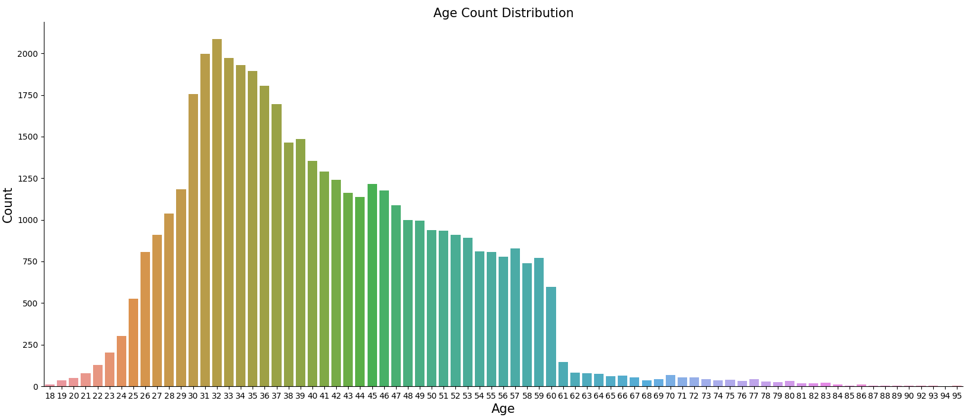
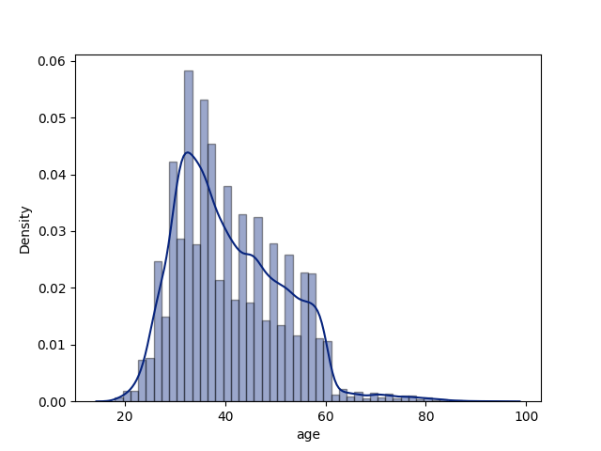
Data Set Description
Age (numeric)
MIN Age: 18 / MAX Age: 95 / MEAN Age: 41
Notes:
These are some features visualization

Slide 4
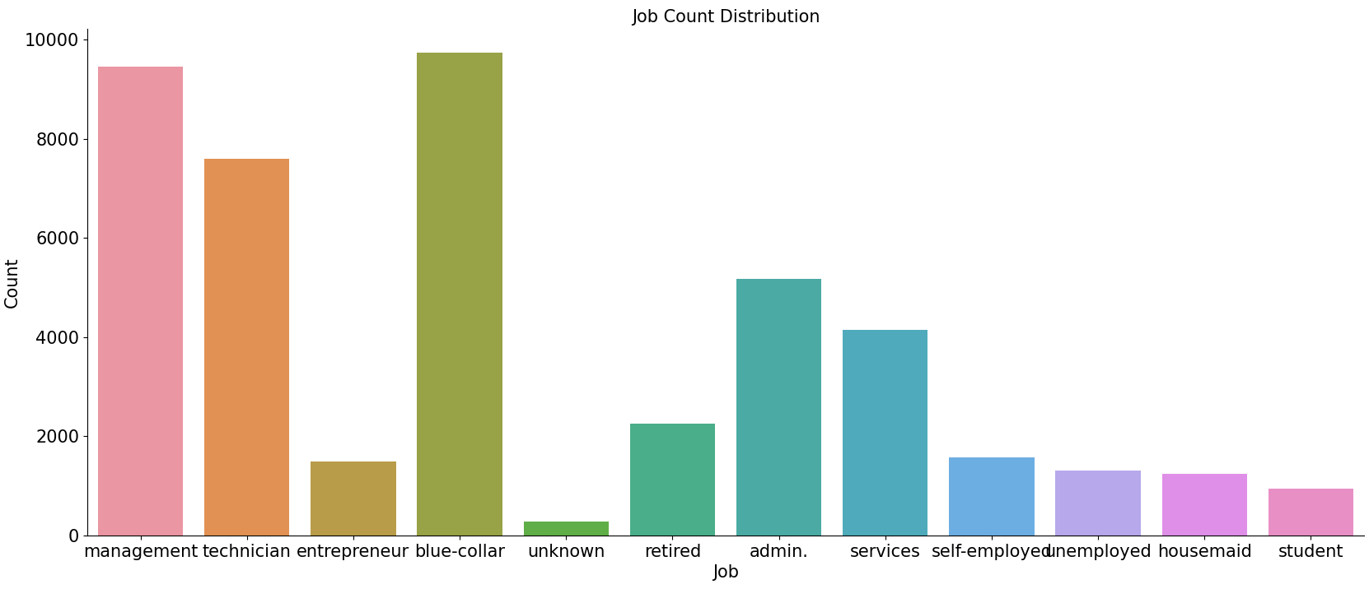
Data Set Description
Job (categorical)
'admin.', 'blue-collar', 'entrepreneur', 'housemaid', 'management', 'retired’,
'self-employed', 'services', 'student', 'technician', 'unemployed', 'unknown'
12 types in total

Slide 5
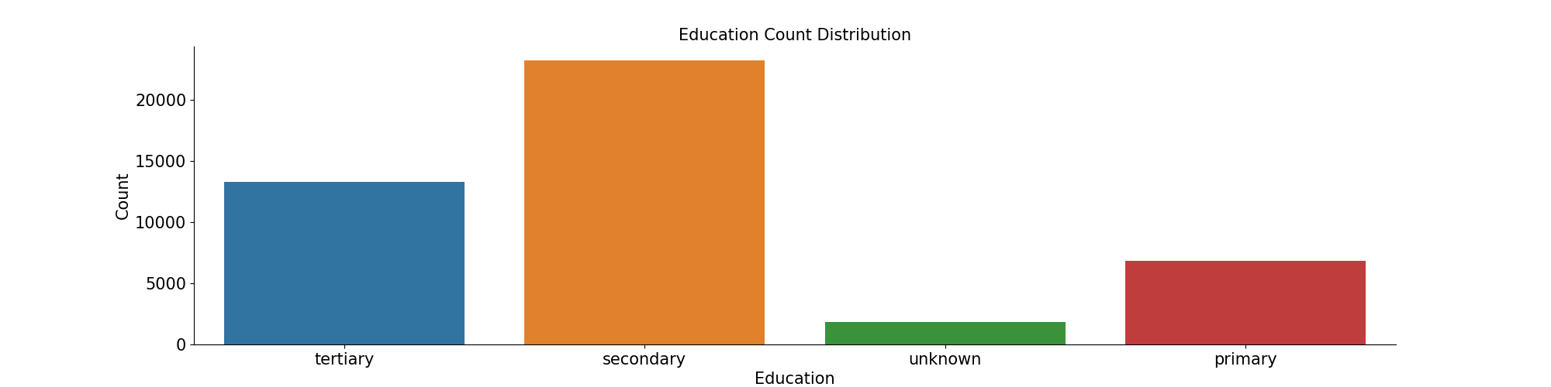
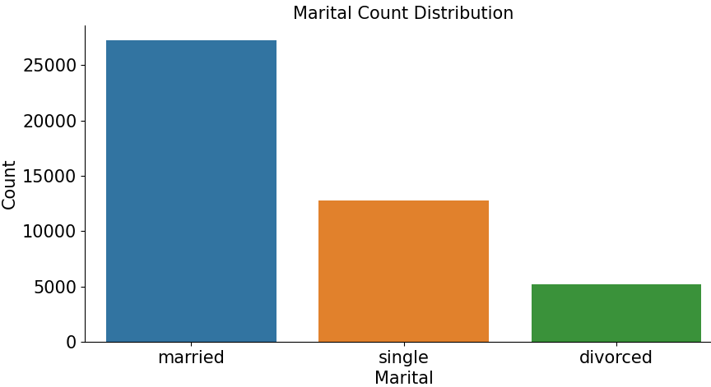
Data Set Description
Marital (categorical)
Education (categorical)
3 types in total
4 types in total
'divorced', 'married’,
'single'
'tertiary', 'secondary’,
'primary', 'unknown'

Slide 6
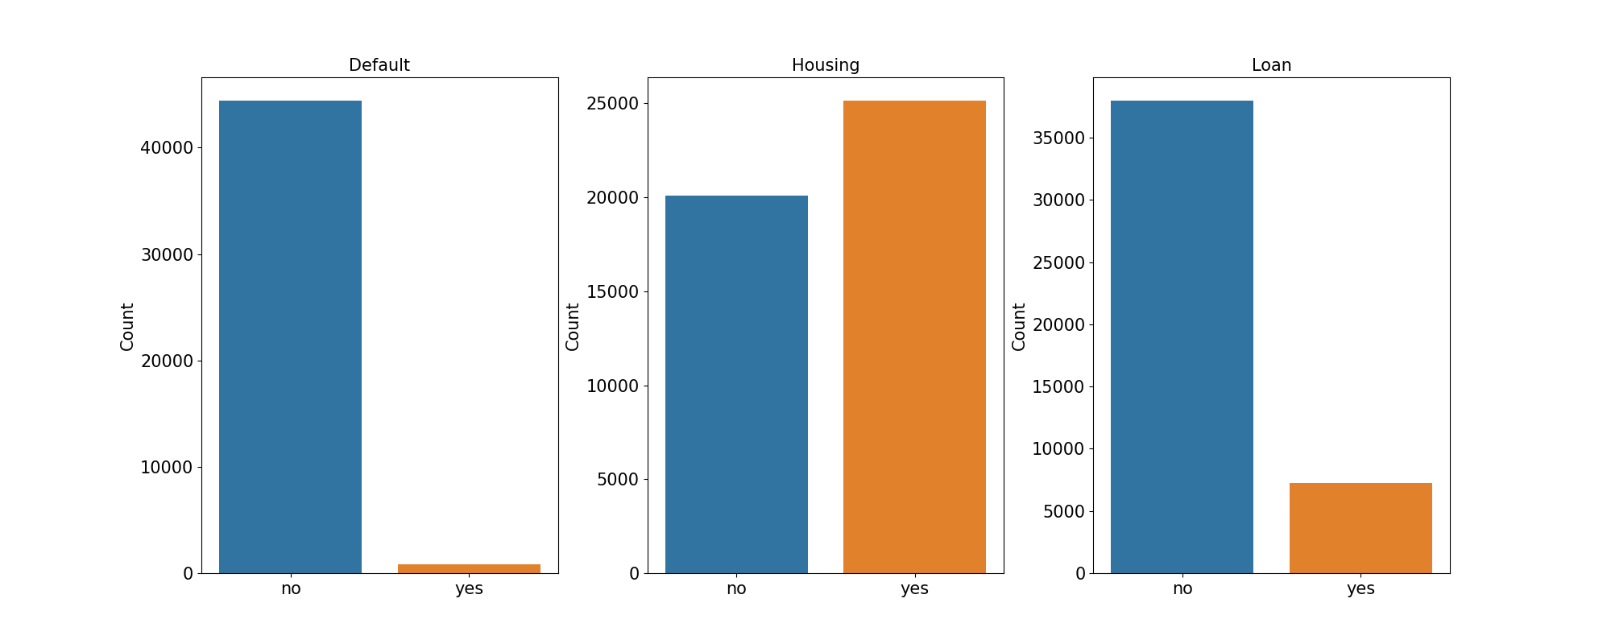
Data Set Description
Default (has credit in default?)
(binary: "yes", "no")
Housing
(binary: "yes", "no")
Loan
(binary: "yes", "no")
2 types in total
2 types in total
2 types in total
Notes:
Default is mean whether it has credit in default

Slide 7
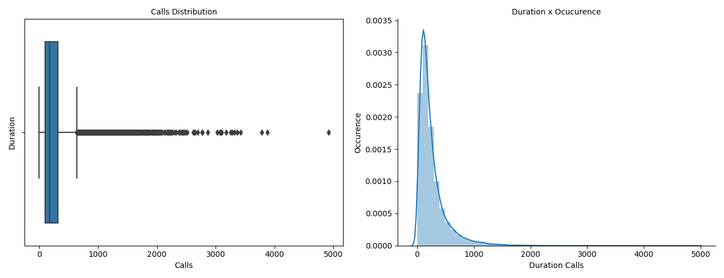
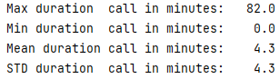
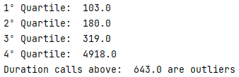
Duration (numeric)
(last contact duration, in seconds)
Data Set Description
Notes:
With max 82 and mean value is 4.3

Slide 8
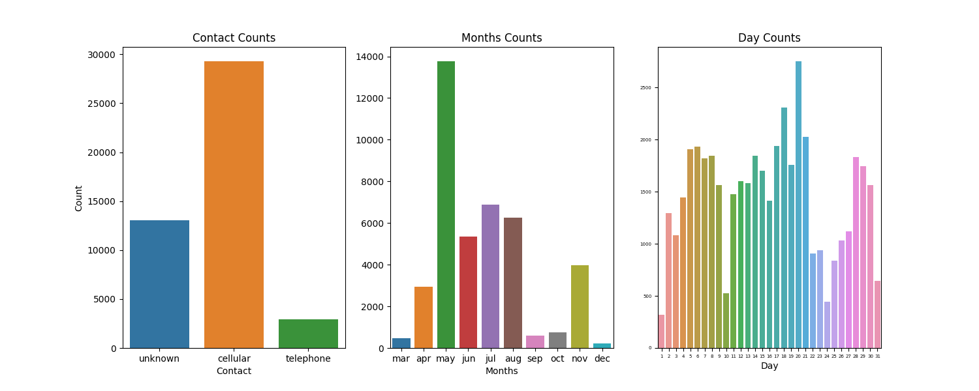
Data Set Description
contact (categorical)
month (categorical)
day (numeric)
3 types in total
12 types in total
31 types in total

Slide 9

Problem Statement
Build a model to be able to predict whether a given individual will sign up for a term subscription if contacted as part of this marketing campaign.
This presentation will explore the dataset provided and use machine learning algorithms to build a predictive model.
At the end, based on the insights generated by the model, we also provide suggestions to individuals in order to increase their term deposit subscription.

Slide 10
Feature Engineering
And
Data Preprocessing

Slide 11
Before we split the data
We view the data and find there is no such thing as NaN, so we are good to go.
I replace no with 0 and yes with 1 for the whole data set
I first make the column”month” into numerical form and then combine “month”, ”day” together and form a new column named “time”, where “time”=(30*”month”+”day”)/360 to describe the timepoint of the last contact.
Notes:
after we view the data, there is no missing value.
i transform the 2-level factor into 0 and 1
i create a new column time describing the period when the last contact was conducted

Slide 12
Before we split the data
I split the column into 2 categories:
numerical:'age','balance','campaign','pdays','previous','duration’,’time’
Categorical(more than 2 levels):'job','marital','education','contact','poutcome'
Now, I do nothing for the numerical column but for categorical columns, I use one hot encoder to transform them into multiple binary columns’ combination.
Notes:
i use onehot encoder to break down the multi-level columns and transform it into binary columns.

Slide 13
Spilt the data
Now we split the data randomly into 2 groups, where the proportion of train and test group is 9:1.
Now we can view the numerical columns in the train group and find the patterns in the label.
Notes:
I then spilt the data

Slide 14
After we split the data
I first view the shape of the data and find the number of different labels.
There is a huge difference between the number of label 1 and label 0.
I oversample on the label 1 and undersample on the label 0
There are about 4500 label 1 in the training set and over 40000 label 0 in the testing set.
I both sample 15000 on the label 1 and 0. For label 1, I sample with replacement and for label 0, I sample without replacement.
Notes:
i find out there are more label 0 than label 1 in the tranining set so I do oversampling and undersamling at the same time so that the model can know the label 1 better

Slide 15
After we split the data
I combine them together and form a new training set and look into the patterns in the numerical columns.
For those numerical columns that are not binary(balance, age, pdays, duration, previous, campaign). I calculate the mean and the std of them in training set and use the mean and the std to z-scale both the training set and the testing set.
I posed a tree-based feature selection and transform the training and testing set using it.(previously, there are 37 columns, now they are 8)
Notes:
for the numerical columns, i use the data in the traning set to z-scale both the traning set and the testing set.
i use a tree based feature selection to get the important columns and remove the unrelated columns

Slide 16
After we split the data
We find out most of the one-hot-encoder and binary columns are not that important or related to the “label”.(only 2 of them left. And the result is unstable).
Ps:since there are randomness when I split the data and sample the training data, the feature selection always preserves the numerical columns that are not binary, but the one-hot-encoder’s column and binary columns that matters might change over times.
I decide to preserve the columns even though they are not stable, because it represents the result of my experience.
Notes:
though some of the columns are unstable, I decided to keep them.

Slide 17
Ensemble Leaning Model Building

Slide 18
model
My method is ensemble leaning:
For the numerical columns that are not binary, I use the gradient boosting tree and for the binary columns, I use the decision tree.
I use 5-fold cross-validation, I do not choose the model with the best performance in the validation group but use the average to decide my final result.(kind of combining the ensemble learning the cross-validation together)
Notes:
my model is emsemble learning and I use a gradient boosting tree to model the stable columns and use a decision tree to model the unstable columns
i also use 5-fold crossing validation

Slide 19
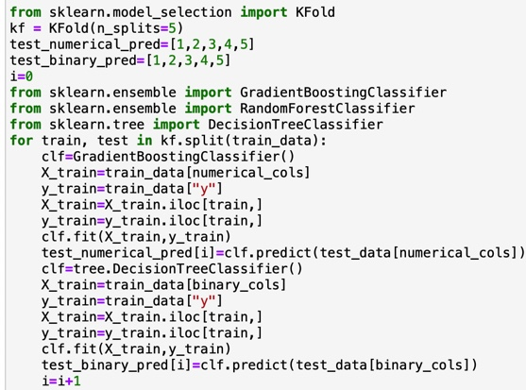
model
Notes:
Since the label distribution in the whole trainning set is different from that in testing set, I did not use the model that perform best in the validation group, but use the max-voting of all the ten classifer.

Slide 20
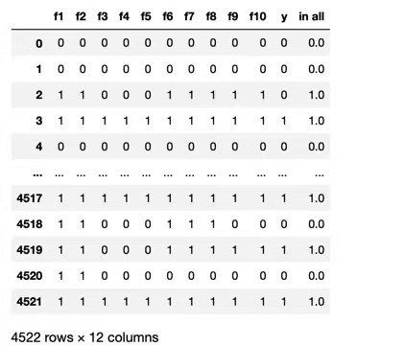
result
416 | 577
123 | 3406
My mcc on the test group is 0.49
My accuracy is 0.85
Notes:
here is my result, the mcc is 0.49 and the acuuracy is 0.85.
Above is just a simple model with feature engineering. Let’s look deep down into the influence of the feature engineering.

Slide 21
Model Performance & Parameter Comparison of Light GBM

Slide 22
1. Initially select models with better performance
Model | Name | Accuracy | AUC | Recall | Prec. | F1 | Kappa | MCC | TT (Sec)
catboost | CatBoost Classifier | 0.9124 | 0.9348 | 0.5580 | 0.6106 | 0.5828 | 0.5340 | 0.5348 | 18.7360
xgboost | Extreme Gradient Boosting | 0.9098 | 0.9308 | 0.5444 | 0.5978 | 0.5696 | 0.5193 | 0.5202 | 2.4140
lightgbm | Light Gradient Boosting Machine | 0.9078 | 0.9324 | 0.6225 | 0.5742 | 0.5970 | 0.5451 | 0.5459 | 5.5300
rf | Random Forest Classifier | 0.9033 | 0.9274 | 0.5351 | 0.5623 | 0.5481 | 0.4941 | 0.4944 | 4.1800
et | Extra Trees Classifier | 0.9010 | 0.9138 | 0.4462 | 0.5612 | 0.4970 | 0.4429 | 0.4466 | 6.4180
gbc | Gradient Boosting Classifier | 0.8822 | 0.9176 | 0.7397 | 0.4763 | 0.5793 | 0.5145 | 0.5315 | 17.5520
ada | Ada Boost Classifier | 0.8783 | 0.8955 | 0.6739 | 0.4623 | 0.5482 | 0.4807 | 0.4922 | 4.4500
dt | Decision Tree Classifier | 0.8728 | 0.7268 | 0.5398 | 0.4355 | 0.4820 | 0.4104 | 0.4135 | 1.1780
ridge | Ridge Classifier | 0.8567 | 0.0000 | 0.7793 | 0.4177 | 0.5438 | 0.4679 | 0.5000 | 0.6360
lda | Linear Discriminant Analysis | 0.8567 | 0.9042 | 0.7793 | 0.4176 | 0.5438 | 0.4678 | 0.4999 | 1.1720
knn | K Neighbors Classifier | 0.8480 | 0.8567 | 0.7342 | 0.3961 | 0.5145 | 0.4338 | 0.4630 | 7.8360
lr | Logistic Regression | 0.8462 | 0.9068 | 0.8062 | 0.4001 | 0.5347 | 0.4548 | 0.4950 | 1.0740
svm | SVM - Linear Kernel | 0.8365 | 0.0000 | 0.8249 | 0.3870 | 0.5260 | 0.4428 | 0.4896 | 0.8060
nb | Naive Bayes | 0.8183 | 0.7920 | 0.6115 | 0.3253 | 0.4246 | 0.3285 | 0.3516 | 0.5580
qda | Quadratic Discriminant Analysis | 0.1097 | 0.5000 | 1.0000 | 0.1097 | 0.1976 | 0.0000 | 0.0000 | 0.7300
Notes:
We should check the effect after FE. The following is the performance of each prior model that we simply use label encoder and standard scaler to process the original data. Among them, the best algorithms are marked as yellow: ACC, AUC, and Precision of the Cat Boost model, while F1, Kappa, and MCC of Light GBM.

Slide 23
2. Choose Light GBM. Right is after Feature Engineering
BEFORE | Accuracy | AUC | Recall | Prec. | F1 | Kappa | MCC
0 | 0.9075 | 0.9319 | 0.6150 | 0.5889 | 0.6017 | 0.5494 | 0.5495
1 | 0.9042 | 0.9261 | 0.6033 | 0.5910 | 0.5971 | 0.5427 | 0.5427
2 | 0.9133 | 0.9369 | 0.6634 | 0.5739 | 0.6154 | 0.5668 | 0.5687
3 | 0.9074 | 0.9312 | 0.6119 | 0.5589 | 0.5842 | 0.5322 | 0.5329
4 | 0.9111 | 0.9348 | 0.6165 | 0.5518 | 0.5824 | 0.5328 | 0.5338
Mean | 0.9087 | 0.9322 | 0.6220 | 0.5729 | 0.5961 | 0.5448 | 0.5455
SD | 0.0032 | 0.0037 | 0.0212 | 0.0156 | 0.0121 | 0.0128 | 0.0131
AFTER | Accuracy | AUC | Recall | Prec. | F1 | Kappa | MCC
0 | 0.8949 | 0.9498 | 0.9354 | 0.8626 | 0.8975 | 0.7901 | 0.7928
1 | 0.8875 | 0.9471 | 0.9356 | 0.8468 | 0.8890 | 0.7756 | 0.7795
2 | 0.8918 | 0.9464 | 0.9261 | 0.8605 | 0.8921 | 0.7839 | 0.7860
3 | 0.8879 | 0.9480 | 0.9265 | 0.8577 | 0.8907 | 0.7760 | 0.7785
4 | 0.8842 | 0.9450 | 0.9199 | 0.8572 | 0.8875 | 0.7685 | 0.7706
Mean | 0.8893 | 0.9473 | 0.9287 | 0.8570 | 0.8914 | 0.7788 | 0.7815
SD | 0.0037 | 0.0016 | 0.0060 | 0.0055 | 0.0035 | 0.0074 | 0.0075
Notes:
Given the excellent MCC performance of Light GBM and its efficient training speed
We choose Light GBM to show the results of FE. Comparing them after 5-folds validation, the accuracy of the model after FE has been reduced and MCC has been extremely improved.

Slide 24
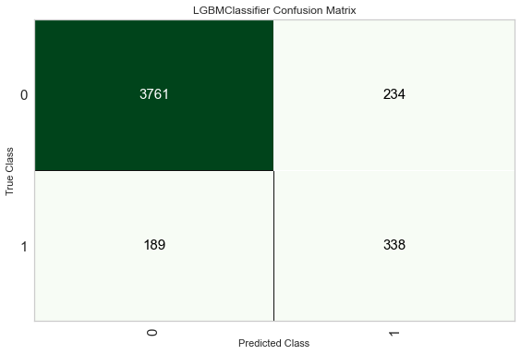
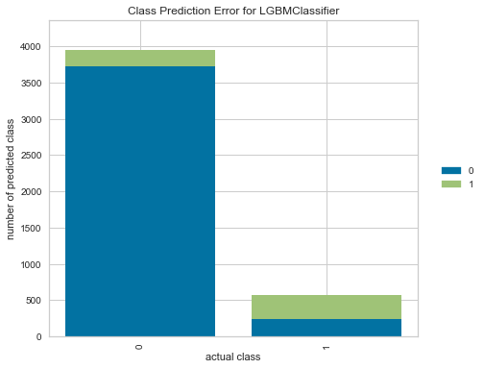
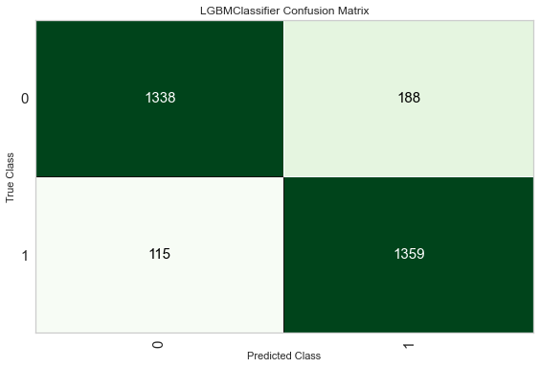
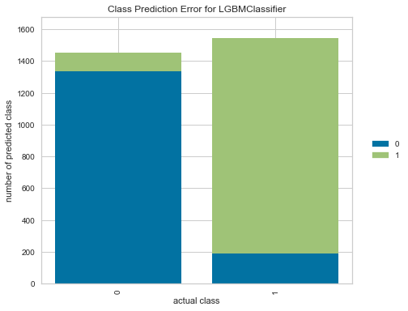
3. Outcome is better by analyze Confusion Matrix & Error
Reason: Due to the large gap in the number of two-category labels in the original data, over-sampling yes label and under-sampling no label at the same time to ensure the effectiveness of the training for the two labels
TN FP
FN TP
TN FP
FN TP
Notes:
Look at our confusion matrix and precision error.
Here our confusion matrix is ​​reversed. Due to the large gap in the binary labels in the original data, over-sampling yes-label and under-sampling no-label at the same time to ensure the effectiveness of the training for the two labels. This makes our training results more balanced.

Slide 25
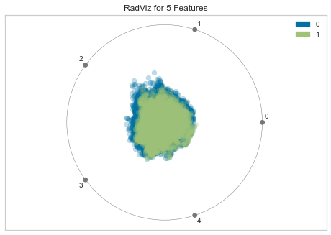
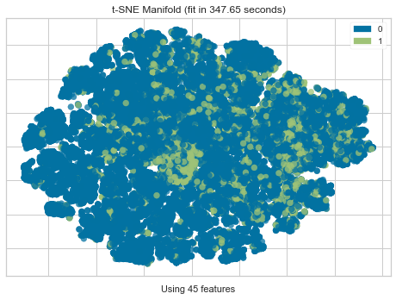
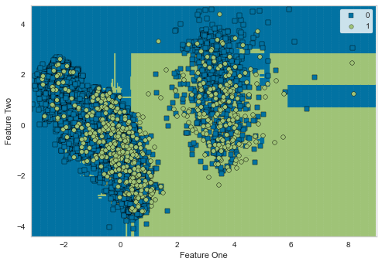
4. Boundary, Dimension & Manifold, Before FE
Notes:
The following is a cluster analysis of Boundary, Dimension & Manifold.
After FE, the main feature dropped from 5 to 2, and the manifold & boundary between the two categories became more obvious, which also confirmed the success of our FE.

Slide 26
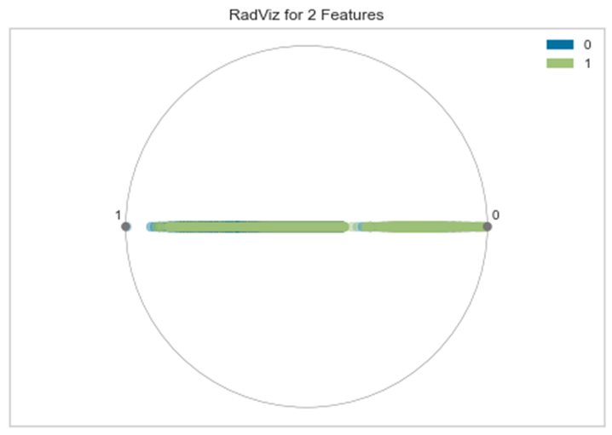
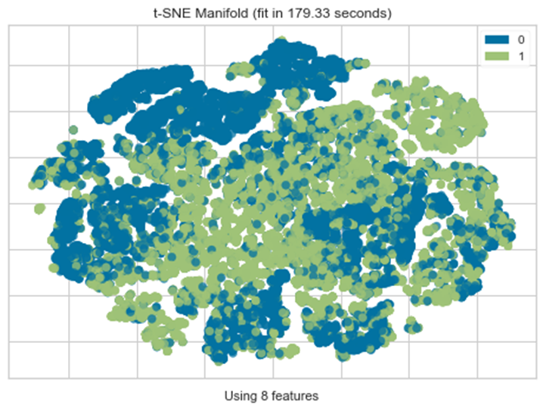
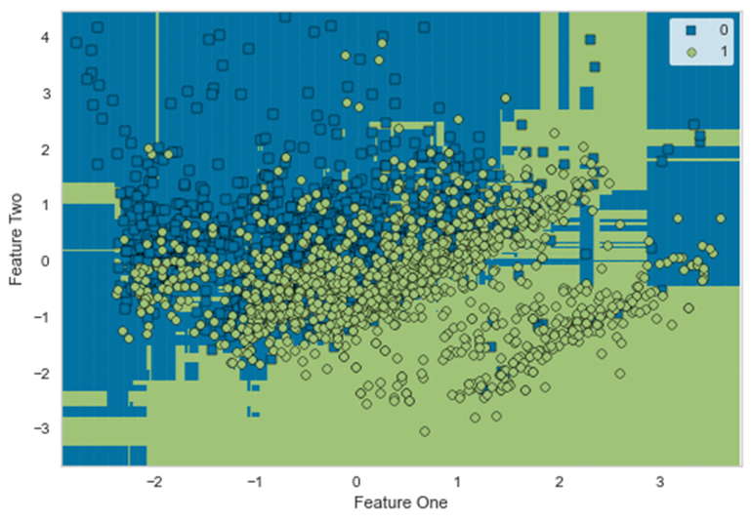
4. Boundary, Dimension & Manifold, After FE
Notes:
The following is a cluster analysis of Boundary, Dimension & Manifold.
After FE, the main feature dropped from 5 to 2, and the manifold & boundary between the two categories became more obvious, which also confirmed the success of our FE.

Slide 27
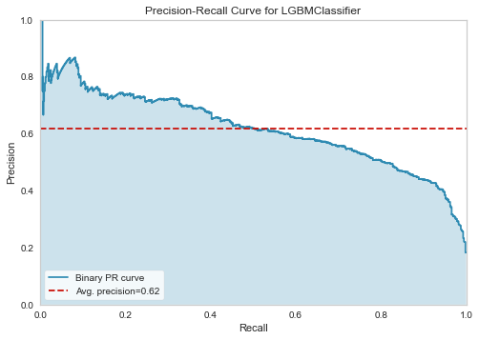
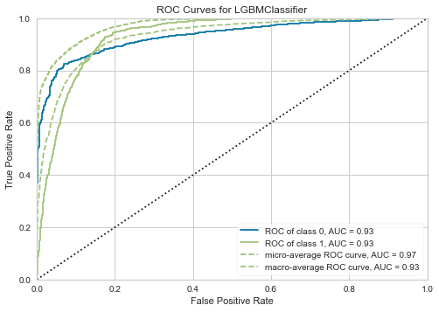
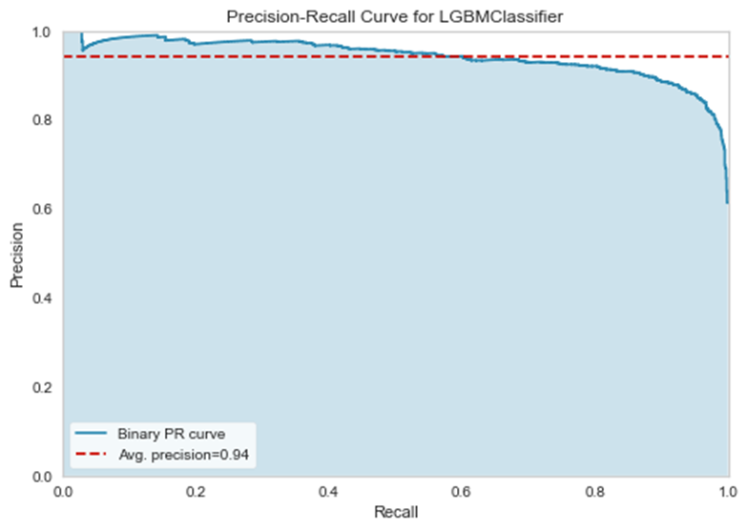
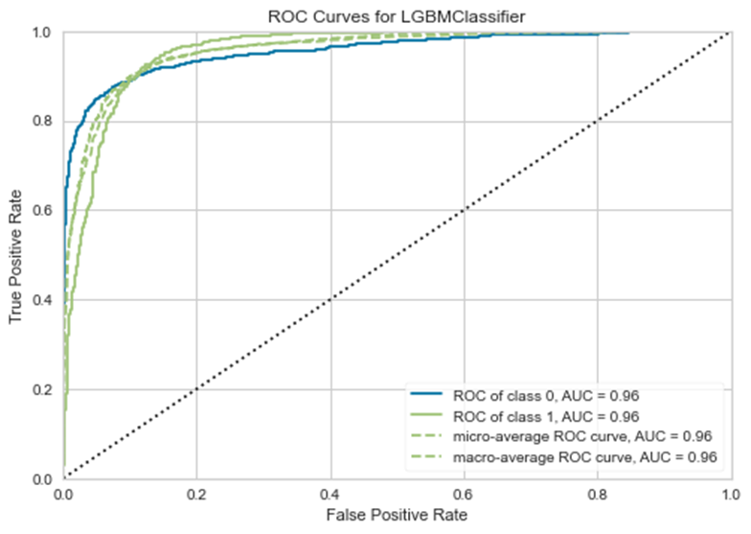
5. ROC & PRC
Before FE
After FE
Notes:
The ROC curve is a graph showing the performance at all classification thresholds.
The P-R curve plots two parameters: Precision & Recall. And AUC stands for Area under the ROC Curve, which measures the entire two-dimensional area underneath the entire ROC curve.
Observing the ROC curve, the AUC of class 1 increases from 0.93 to 0.96 after doing FE.

Slide 28
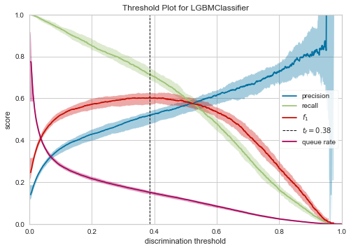
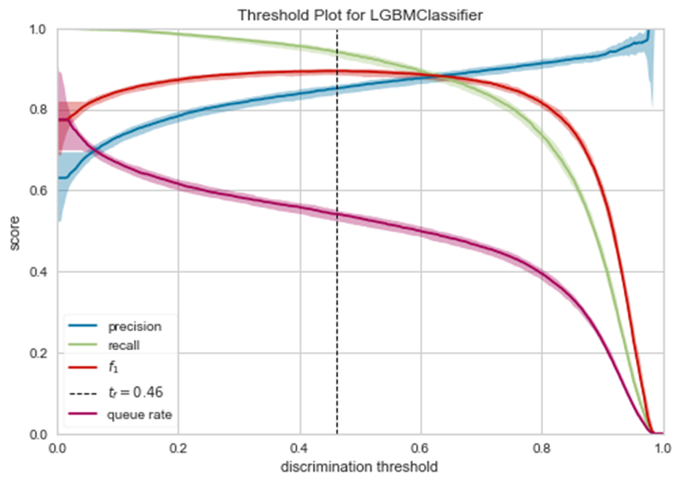
6. Threshold Plot, Before FE
If Prediction > Threshold, it is classified to yes.
If Prediction < Threshold, it is classified to no.
Notes:
Threshold Plot.
When analyze the ROC curve, the optimal threshold of the classifier can be directly calculated. To be more precise, it is possible to use a grid search to tune the threshold and locate the optimal value. The result clearly shows the optimal threshold is 0.38 for imbalanced classification. After FE balanced the number of labels, threshold increases to 0.46.

Slide 29
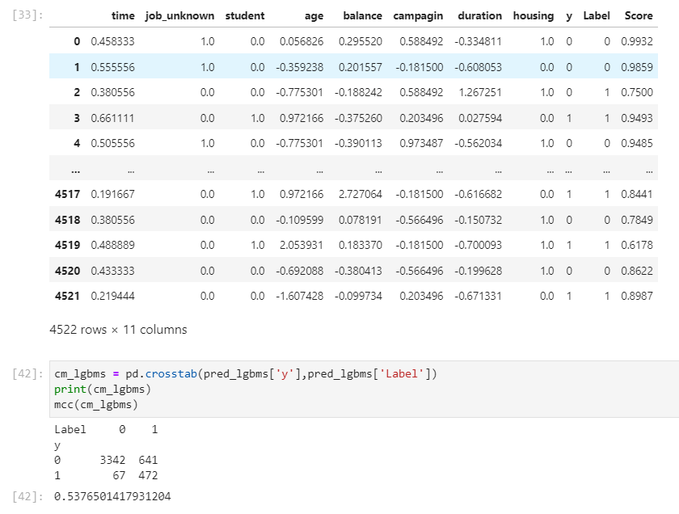
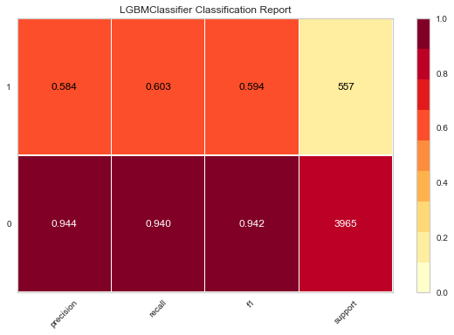
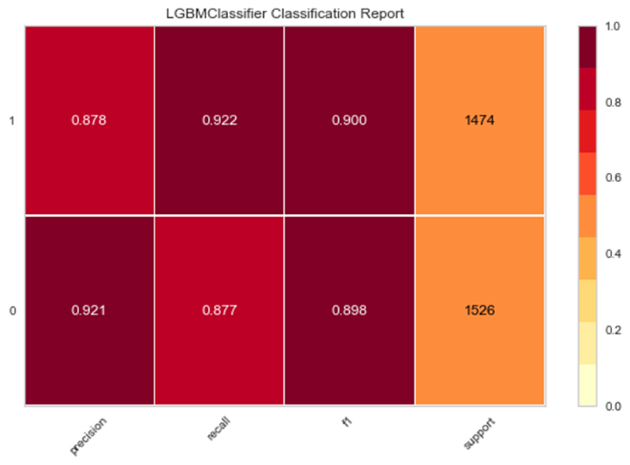
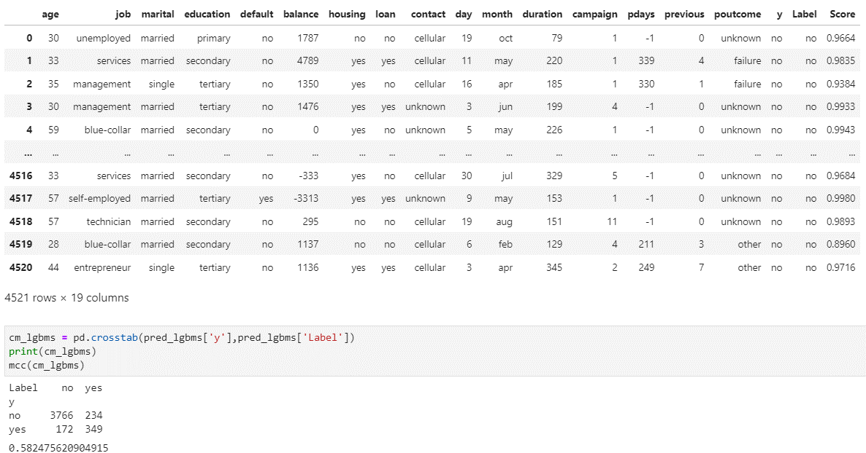
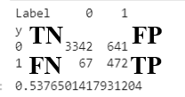
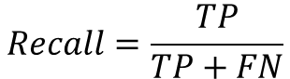
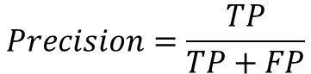
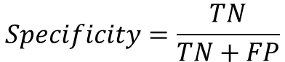
7. Predict and Evaluation, After FE
$$Recall=\frac{TP}{TP+FN}$$
$$Specificity=\frac{TN}{TN+FP}$$
$$Precision=\frac{TP}{TP+FP}$$
TN FP
FN TP
Notes:
This is a comparison of our prediction results before and after FE. Although MCC has decreased, consider the real business scenario, as a marketing analyst for a bank, we want to identify users who may subscribe to a term deposit but have not yet subscribed. Such classes will belong to False Positives users who are expected to make a subscription but do not make it. Therefore, in addition to TP and TN, we also prefer FP and work on reducing them.
So, the Recall increased, which provides the percentage of correctly predicted target customers increased.
The Specificity gives us the percentage of non-target customers that are correctly predicted.
The Precision increased, it provides us with the increase of efficiency of prediction because we can get as much TP with as few resources as possible.
Thus our work performance and efficiency have been obtained a great improvement.

Slide 30
Ada Boost + Gradient Boost Model Building

Slide 31
AdaBoost
Main idea of Adaboost：boosting and vote
Main procedure：
1: firstly train the first week classifier with N train_datas
2: train the second week classifier with wrongly classified data and
some new train_datas.
3: continue step 1 and 2 until we get enough classifiers
4: every classifier will run classification task on the same test data
then, we get predictions: P₁,P₂,P₃……P_{M}
5: finally every classifiers vote according to their weights as the final prediction results
Advantages:
1: No need for feature election
2: No need to care about overfitting
3: simple model for every week classification
Why I choose Adaboost:
1:Too many features in the dataset and cannot tell the
Importance of each feature.
2: Binary classification——too many 0 and fewer 1

Slide 32
The model of Adaboost：
The API from sklearn：
sklearn.ensemble.AdaBoostClassifier(
base_estimator=None, # type of basic estimators
n_estimators=50, # number of estimators
Learning_rate=1.0,
algorithm=‘SAMME.R’,
random_state=None）
We need to adjust the 3 hyper parameters to find the best

Slide 33
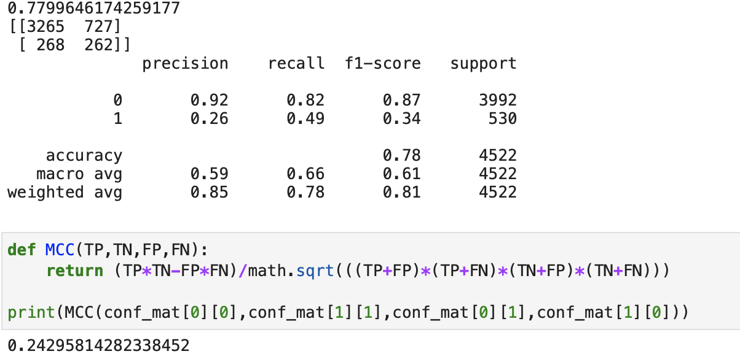
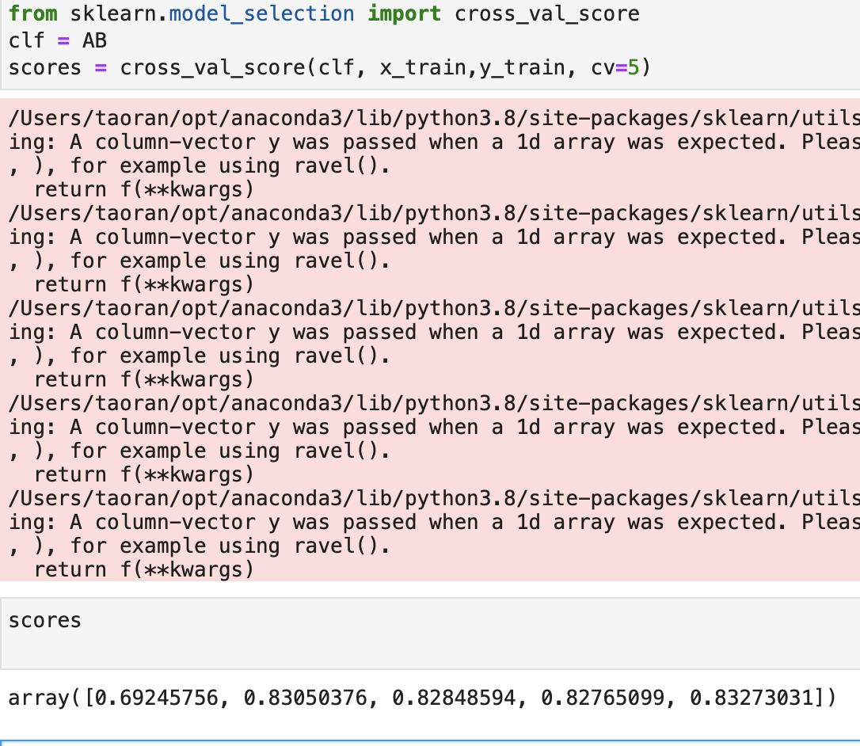
Adaboost results：
Without feature engineering： 5-fold cross validation:
We have high accuracy on label 0 but low precision for 1
which will cause loss for the bank
—>because of the unbalanced dataset， too many zeros
and too few ones
—>we should make the dataset as balance as possible

Slide 34
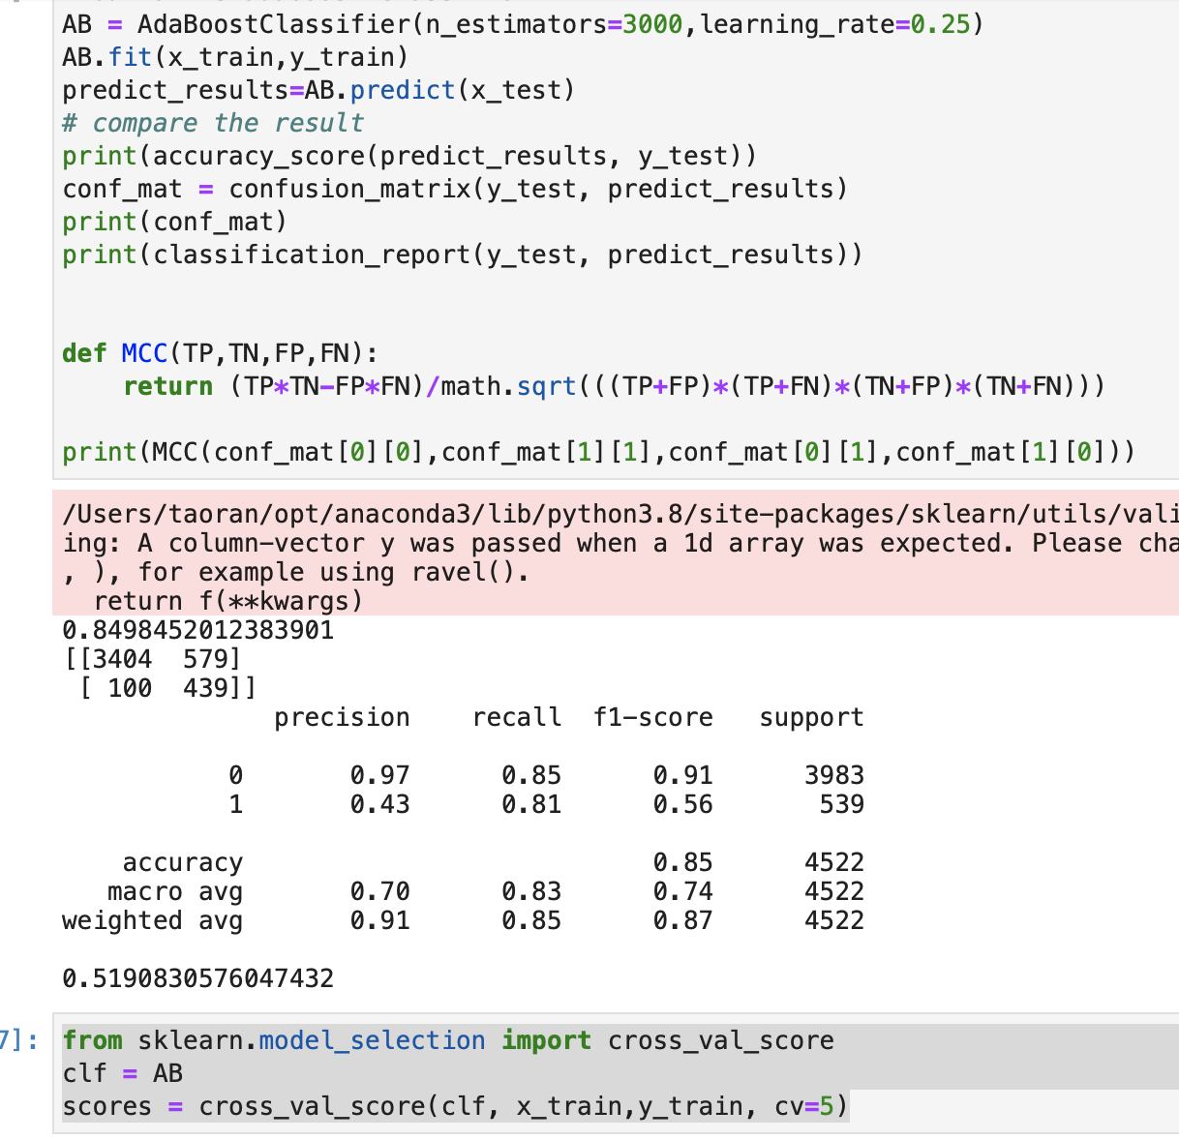
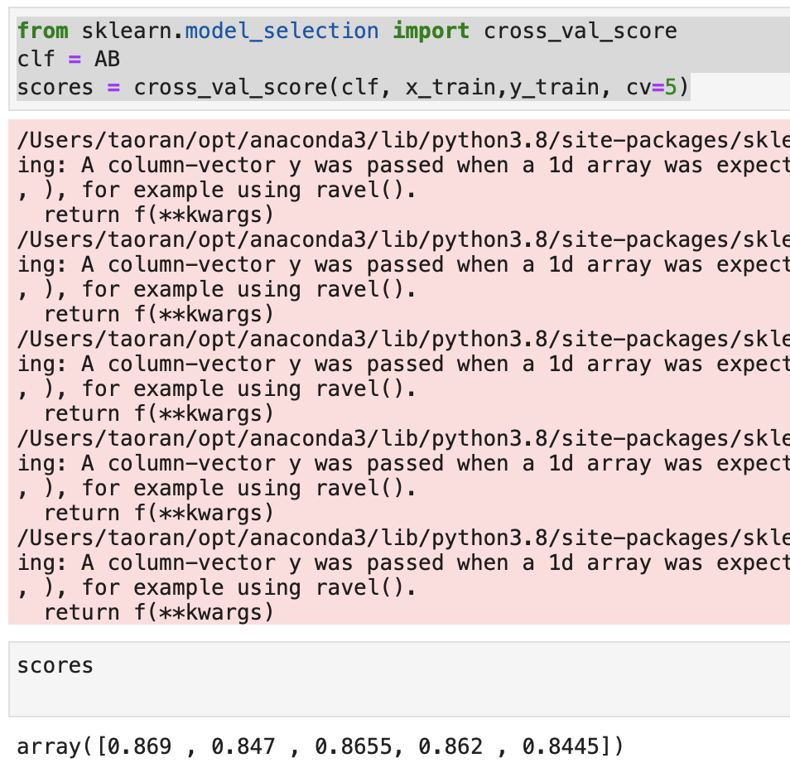
Adaboost results
After feature engineering and oversampling： 5-fold cross validation:
Improvement:
1:TP TN increase && FP FN decrease
2: accuracy and MCC both increase.
Oversampling has improved the ability to classify the data of label 1
Guess： we can improve the model from the way of boosting.

Slide 35

Gradient boost
Comparison to Adaboost:
difference mainly locates on the Loss:
Adaboost: Exponent Loss Gradientboost: any loss we want with gradient
Disadvantages：sensitive to noisy points
We can use some robust loss function, making the
Model less sensitive to the noise.
Useful API in sklearn: sklearn.ensemble.GradientBoostingClassifier(
loss{‘deviance’, ‘exponential’}, default=’deviance’
learning_ratefloat, default=0.1
n_estimatorsint, default=100
)

Slide 36
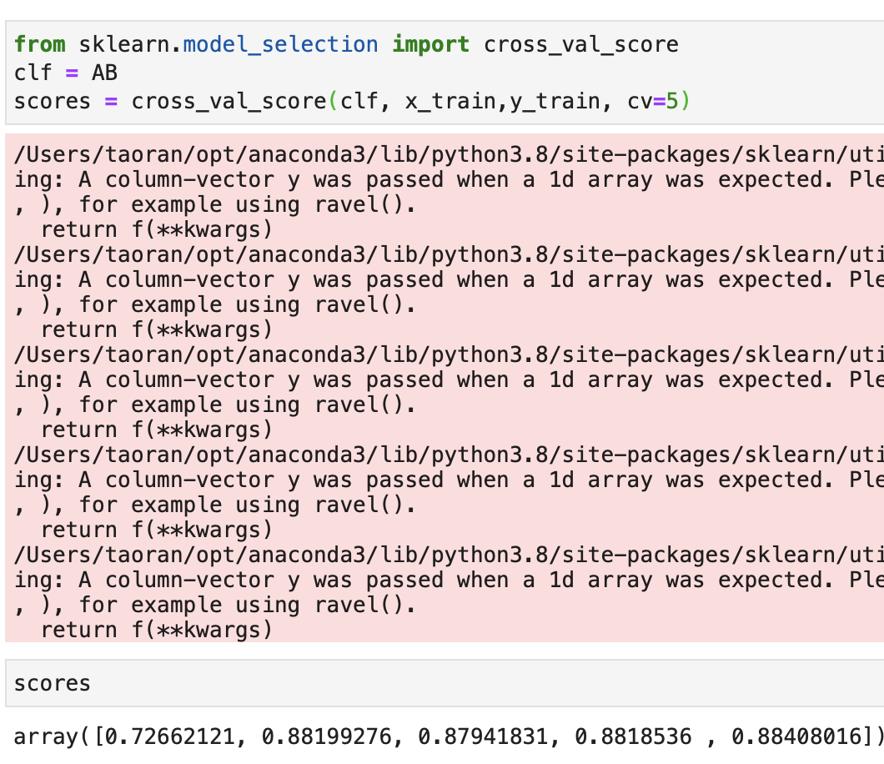
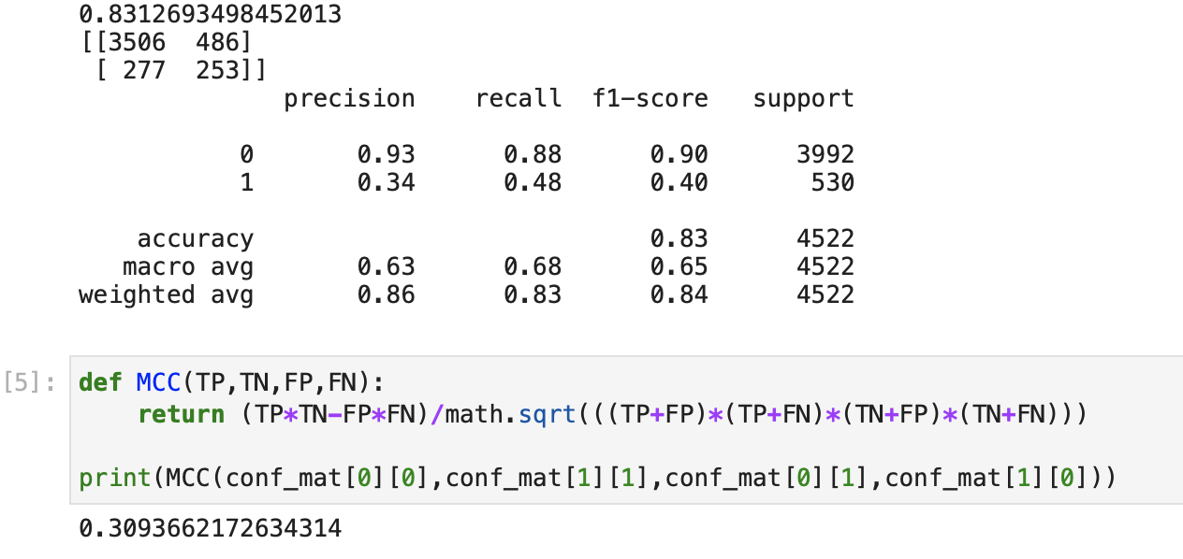
Gradient Boost result:
Without feature engineering and oversampling： 5-fold cross validation
Huge improvement on MCC in row data

Slide 37
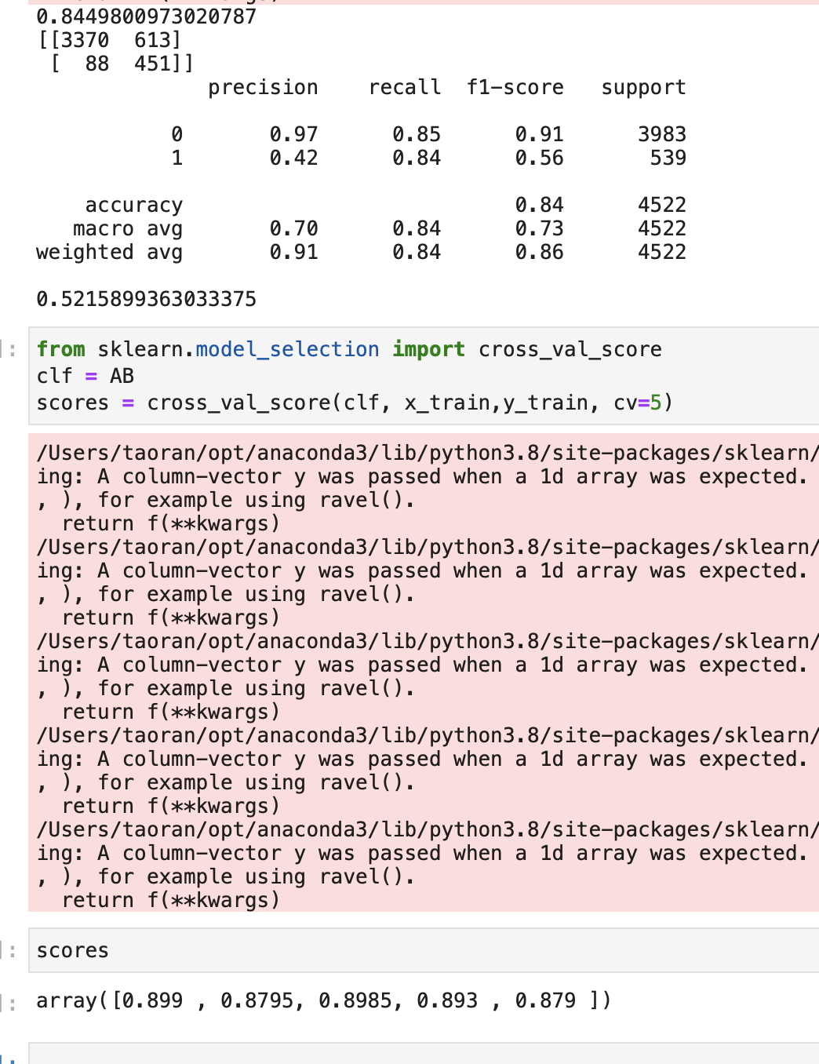
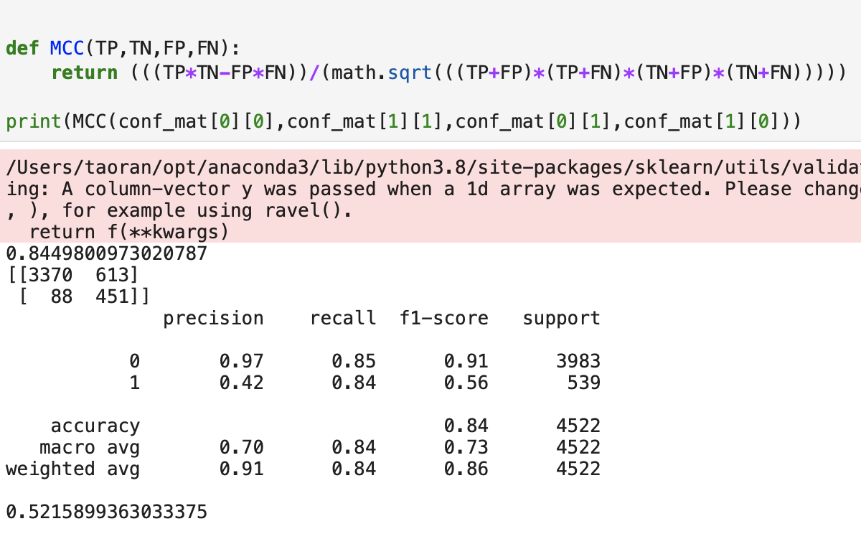
Gradient Boost result:
5-fold cross validation：
After feature engineering and oversampling：
The best result

Slide 38
RandomForest Model Building

Slide 39
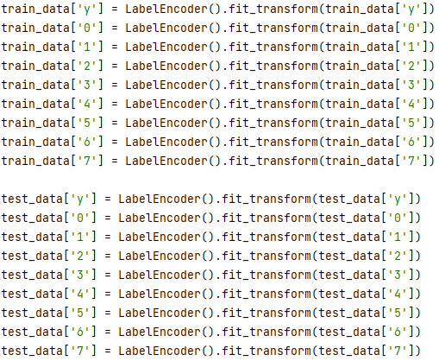
Data Preprocessing
Using LabelEncoder() in the 'sklearn' package, I encode each target label with value between 0 and n_classes-1.
fit.transform(): fit label first, then return encoded labels.

Slide 40
Model Setting
Set the 'RandomForestClassifier' in the 'sklearn' package
n_estimators: The number of decision trees in the forest
random_state: to ensure reproducibility.
oob_score=True: use Out-of-Bag Score to estimate the training accuracy.
oob_score definition: because the Random Forest uses a bootstrap training, such a put-back sampling approach results in some of the samples in the training set (about 36.8%) not entering in the sampling set of the decision tree. This uncollected sample is called the out-of-bag data.
For a single decision tree trained with the sampling set, an oob_score(R square) is generated after running with the out-of-bag data. Repeating the above operation for each decision tree will eventually result in 100 oob_scores and averaging these oob_scores will eventually result in an oob_score for the entire Random Forest.

Slide 41
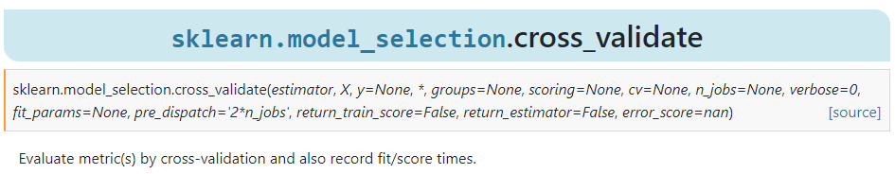
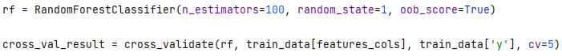
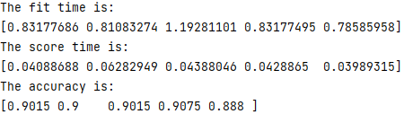
5-fold Cross Validation
Although there is the cross_validate function in the 'sklearn' package, it can’t output the MCC for evaluation.
Only it can output the 'fit_time’, the 'score_time’, and the 'test_score’.

Slide 42
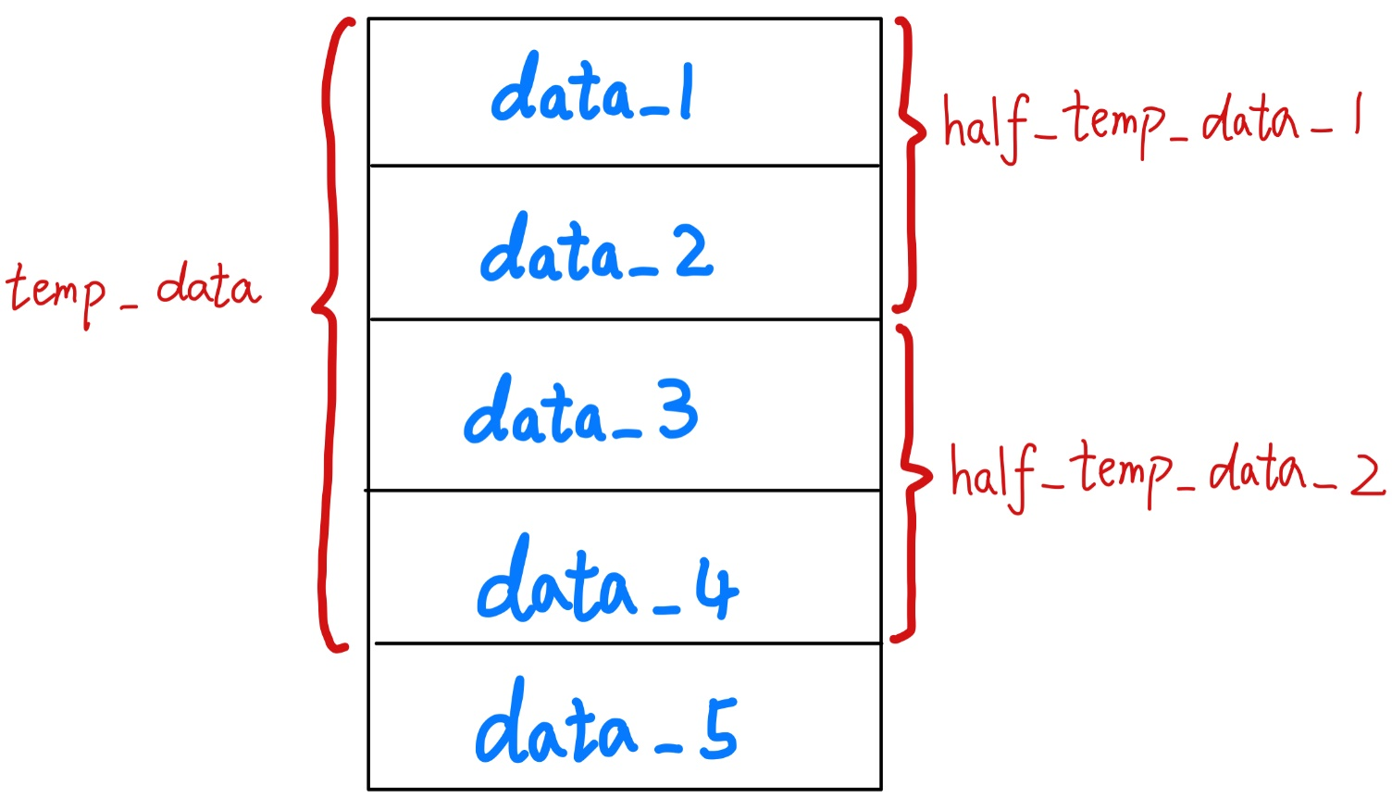
5-fold Cross Validation
So, I manually divided the training set into 5 parts follow by this way:
Just want to see these five models’ MCC Score and Out-of-Bag Score.

Slide 43
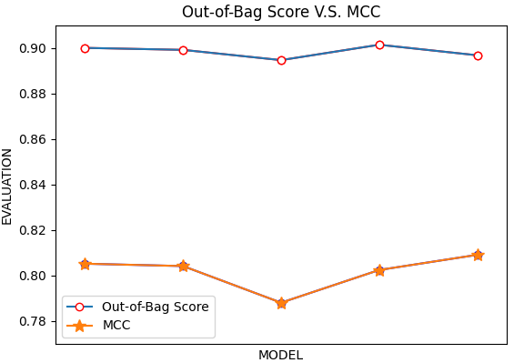





Out-of-Bag Score V.S. MCC
Out-of-Bag Score and MCC Score are not positively correlated.

Slide 44
MCC Score
However, it is wrong to apply the MCC Score to the training set.
The MCC Score is specific responds to sample imbalance.
Because the training set is very balanced, the MCC score will appear to be inflated.
In the test set, the MCC Score will be much lower due to the unbalanced samples.

Slide 45
MCC Score
But we can still use this score because our goal is to get the MCC Score as high as possible, not to get the Accuracy as high as possible.
So instead of choosing the model with the high accuracy (model 4) to apply to the test set, we should choose the model with the high MCC Score (model 5) to apply to the test set.

Slide 46
Finally
In the end, I ran both model 4 and model 5.
The result is that the model with the high MCC Score will end up with a high MCC Score in the test set.
And the one with high accuracy does not necessarily have high MCC Score.

Slide 47

Future Directions for further Improvements
Future Directions for further Improvements
For curiosity, I deleted the LabelEncoder procedure, simply just put the original data into the Random Forest. Surprisingly, I got the better result !!

Slide 48
Future Directions for further Improvements
Future Directions for further Improvements
with LabelEncoder
without LabelEncoder
Notes:
with LabelEncoder, we have MCC 0.47
But without LabelEncoder, we have MCC 0.50

Slide 49
Future Directions for further Improvements
Future Directions for further Improvements
From my perspective, I think L2 Regularization data is more suitable for the random forest.
The LabelEncoder() is just suitable for using with categorical character types labels
In conclusion, do the LabelEncoder() for categorical character first, then do the L2 Regularization, just like the work we do in feature engineering.

Slide 50

ROC

Slide 51
Logistic Regression Model Building

Slide 52

I use sklearn to develop my logistic regression model
Notes:
I use sklearn to develop my logistic regression

Slide 53

Model Evaluation
Confusion matrix

Slide 54
Model Evaluation
ACC
MCC
Five-fold Cross Validation Score: <mean>
Notes:
the ACC is around 0.82 and MCC is around 0.45. My mean five-fold cross validation score is 0.80.

Slide 55
Business Insights
Target Customers
Fixed Pattern
Notes:
For the business insights part, we focus to find target customers and develop a certain pattern to help us be more effective.

Slide 56

Feature Importance, Before FE

Slide 57


Feature Importance, After FE
Notes:
Based on feature importance before and after the feature engineering, I choose 5 attributes of them including age, job, poutcome, contact and time.

Slide 58



Interpret of Model
Notes:
By the way, the duration seems very important in the model, however, the goal is to seek best candidates who will have the best odds to subscribe, the call duration can’t be known before. So this feature will not be covered.

Slide 59
Age: older vs. middle vs. young
Replacing the continuous variable “age” by this categorical variable. We slice the age feature at 30 years to make three easily interpretable classes : [0, 30), [30, 60) and [60, +).
GROUP | NO | YES | PROPORTION
Older(>60y) | 54.5% | 45.5% | 2.2%
Middle(30~60y) | 90.6% | 9.4% | 79.9%
Young(<30y) | 84.8% | 15.2% | 17.9%
The banks are not very much interested by contacting the older population. However, that elderly people are more likely to subscribe.
While the middle group is opposite.
Older | Middle
Contact less | Contact more
More likely to subscribe | Less likely to subscribe
Notes:
For the attribute: age, we slice the age feature at 30 years to make three easily interpretable classes. They are older, middle and younger group. From the table, we can easily find that the banks are not very much interested in contacting the older population and the group proportion is only 2.2%. However, older people are more likely to subscribe, with a percentage of 45.5. While the middle group is opposite: banks are interested in them, but only 9.4% of them are likely to subscribe.

Slide 60

Job: have vs. don’t have
The top three categories show the best relative frequencies of term deposit subscription, they are:
students (31.4%)
retired people (25.2%)
unemployed (14.2%)
ALL These people don’t have a current job!
Maybe they are less sharp…
Notes:
For the attribute: job, we find the top 3 categories which show the best relative frequencies of term deposit subscription, they are students, retired people and unemployed people. The 3 groups have something in common, that is: all these people don’t have a current job. So we guess the reason might be these kind of people are less sharp…and have more time and patience with the telemarketer.

Slide 61

Poutcome: repeat customer
65.6% of people who already subscribed to a term deposit after a previous contact have accepted to do it again.
Even if they denied before, they’re still more enthusiastic to accept it (14.1%) than people who haven’t been contacted before (9.0%).
So even if the previous campaign was a failure, recontacting people is important.
Notes:
For the attribute: poutcome which means whether the customer is a repeat customer. We can tell from the graph that a majority of repeat customers accepted it again. For the customers who didn’t accept it last time, they’re still more enthusiastic to accept it than people who haven’t been contacted before.

Slide 62
Contact: Modern vs. Traditional?
14.7% of cellular responders subscribed to a term deposit while only 5.2% of telephone responders did.
May because...Cellphones are portable and popular nowadays while only some of company use telephones.
14.7%
14.7%
Vs.
5.2%
A scene: an officer receives a call from the telemarketer on the office telephone at work time, the only thing he can do is say “no” to the telemarketer.
Notes:
And the contact method also matters. Cellular responders who accept the subscription is 3 times of that in telephone responders. The reason for the difference might be that cellphones are more popular as personal use, while telephones are more used in office. Imagine a scene an officer receives a call from the telemarketer on the office telephone at work time, the only thing he can do is say “no” to the telemarketer.

Slide 63

Time: which month?
It is interesting:
The graph shows that the company seems like to achieve a performance goal in a certain month like May, but the efficiency is really low.
Notes:
Month is also significant. It seems that some performance goal needs to be achieved for the company in a certain “busy month” like May, but the return is relatively low.

Slide 64
Time: which month?
MONTH | TOTAL AMOUNT | YES
March | 1.3% | 50.6%
April | 6.4% | 20.5%
May | 33.4% | 6.5%
June | 12.9% | 10.4%
July | 17.4% | 9%
August | 15.0% | 10.6%
September | 1.4% | 45%
October | 1.7% | 44%
November | 10% | 10.1%
December | 0.4% | 48.9%
The highest spike occurs during May, with 33.4% of total contacts, but it has the worst ratio of subscribers over persons contacted (6.5%).
Every month with a very low frequency of contact (March, September, October and December) shows very good results (between 44% and 51% of subscribers).
Maybe the company need to plan their time in advance!
Notes:
However, in some months like March and September, when they just make a small number of phone calls, the return is really high.

Slide 65
Summary: Target Customer & Fixed Pattern
WHO?
Best choice: Older people (Young students are also okay).
Better if he is a repeat costumer.
WHEN?
In advance of the “busy time”, maybe March, September, October and December.
HOW?
By cellphone number.
ATTENTION!
Contact more than once.
Extend your conversation time.

Slide 66
Summary of Project Achievements
Build varieties of models and ensembles: (SIX MODEL)
ensemble model (gradient boosting tree + decision tree)
Light GBM
Ada Boost
Gradient Boost
Random Forest
Logistic Regression
For model understanding, We all do the detailed Training and Testing Procedure and Experimental Study and Analysis (but lack of time to show in presentation)
MCC: 0.49
MCC: 0.58
MCC: 0.51
MCC: 0.52
MCC: 0.50
MCC: 0.45

Slide 67

Summary of Project Achievements
We do the right and detailed Feature Engineering, improve all our models: (such as)
And we do insights about our business problem (HIGHLIGHT)
Ada Boost
Gradient Boost
Random Forest
MCC: 0.24 -> 0.51
MCC: 0.28 -> 0.52
MCC: 0.41 -> 0.50
improve the target customer to subscribed a term deposit

Slide 68


Future Directions for further Improvements
This is train_data
without LabelEncoder
This is train_data
with LabelEncoder

Slide 69

5-fold Cross Validation
The original 5-fold cross validation was to take the average of the 5 models.
However, this is the Random Forest (100 Decision Tree). For each time the sample is different, the Decision Tree will completely different. So, there is no averaging of parameters.
Under this circumstance, here is taking the best model.

